Slide 1
Week 4 Submission
Preliminary QA Analysis of FourSquare API

Slide 2
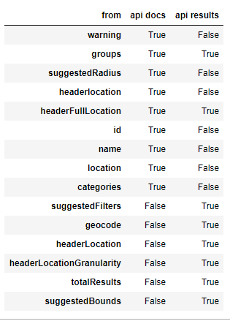
Bad API Documentation

Slide 3
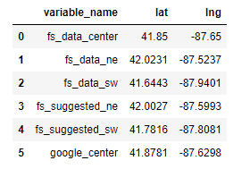
Inconsistent Data

Slide 4
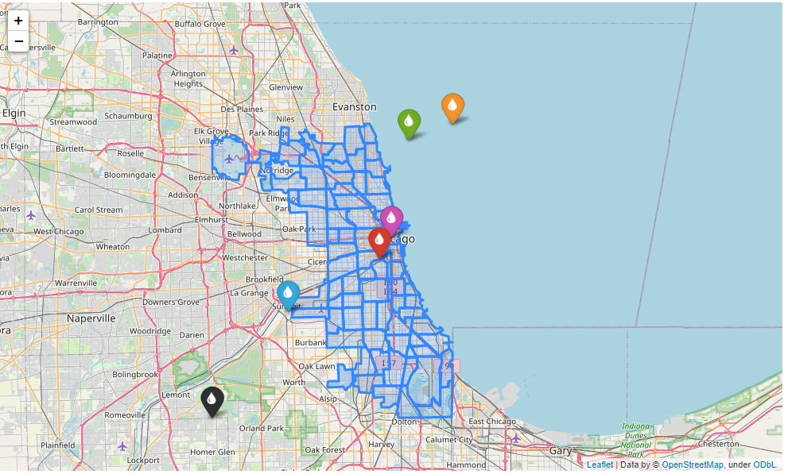
Bad Location Data

Slide 5
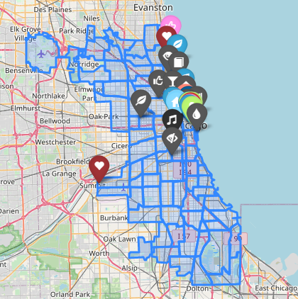
Data Bias

